Slide 1
Data visualization, Day 2: 9-10am

Slide 2
Content
PCA/TSNE
Clustering
heatmap
ggplot2 and publication-ready figures

Slide 3
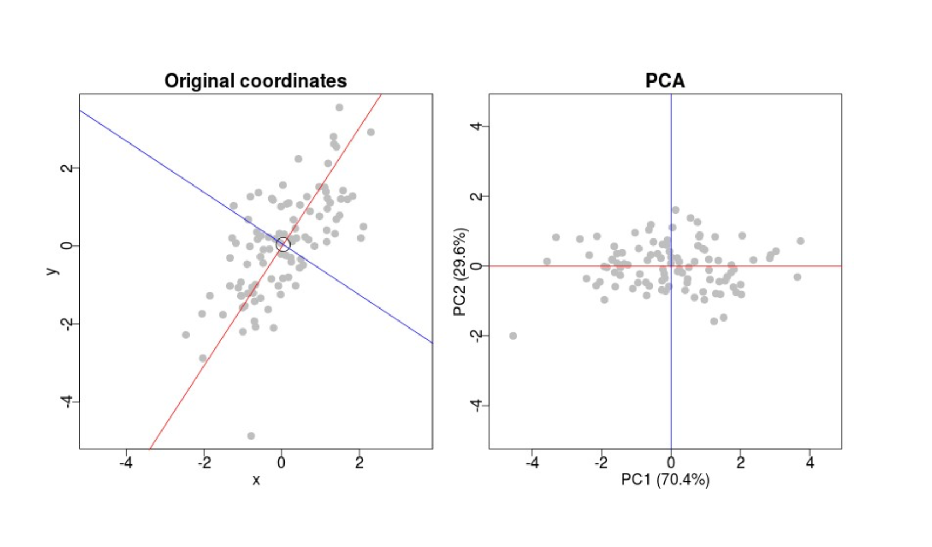
PCA. How it work?
How PCA work?
Project data to multidimensional space
Select the vector that best describes the variation of the data, it will be PC1;
Select the vector that best describes data variability AND not PC1, it will be PC2 (likely it will be a perpendicular to PC1);
Proceed to PC3… PCn

Slide 4
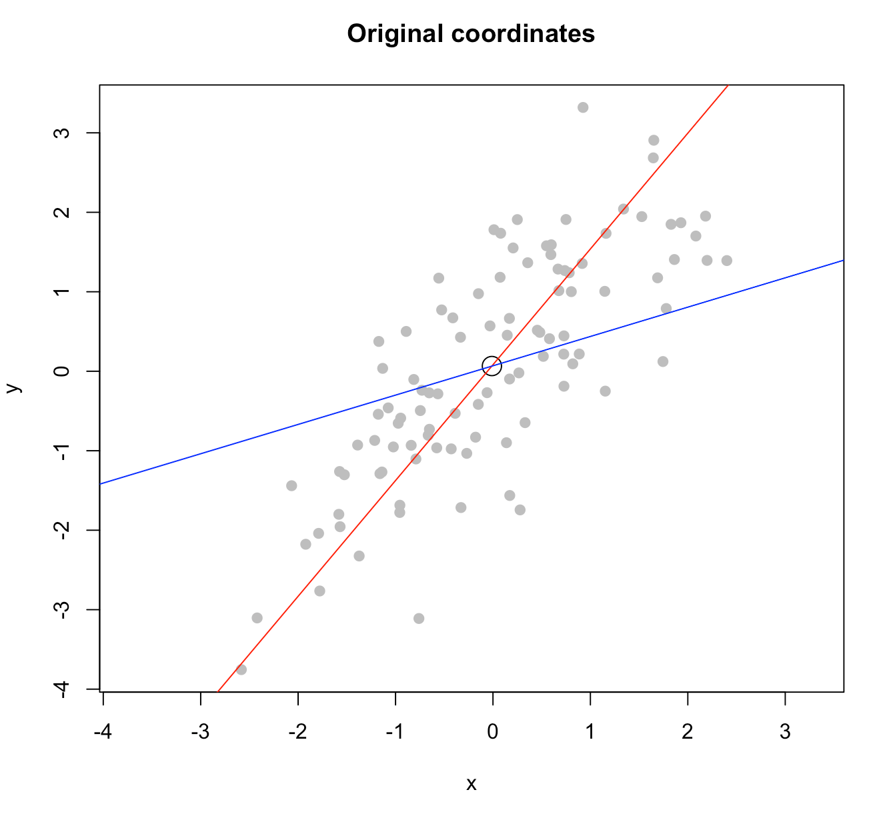
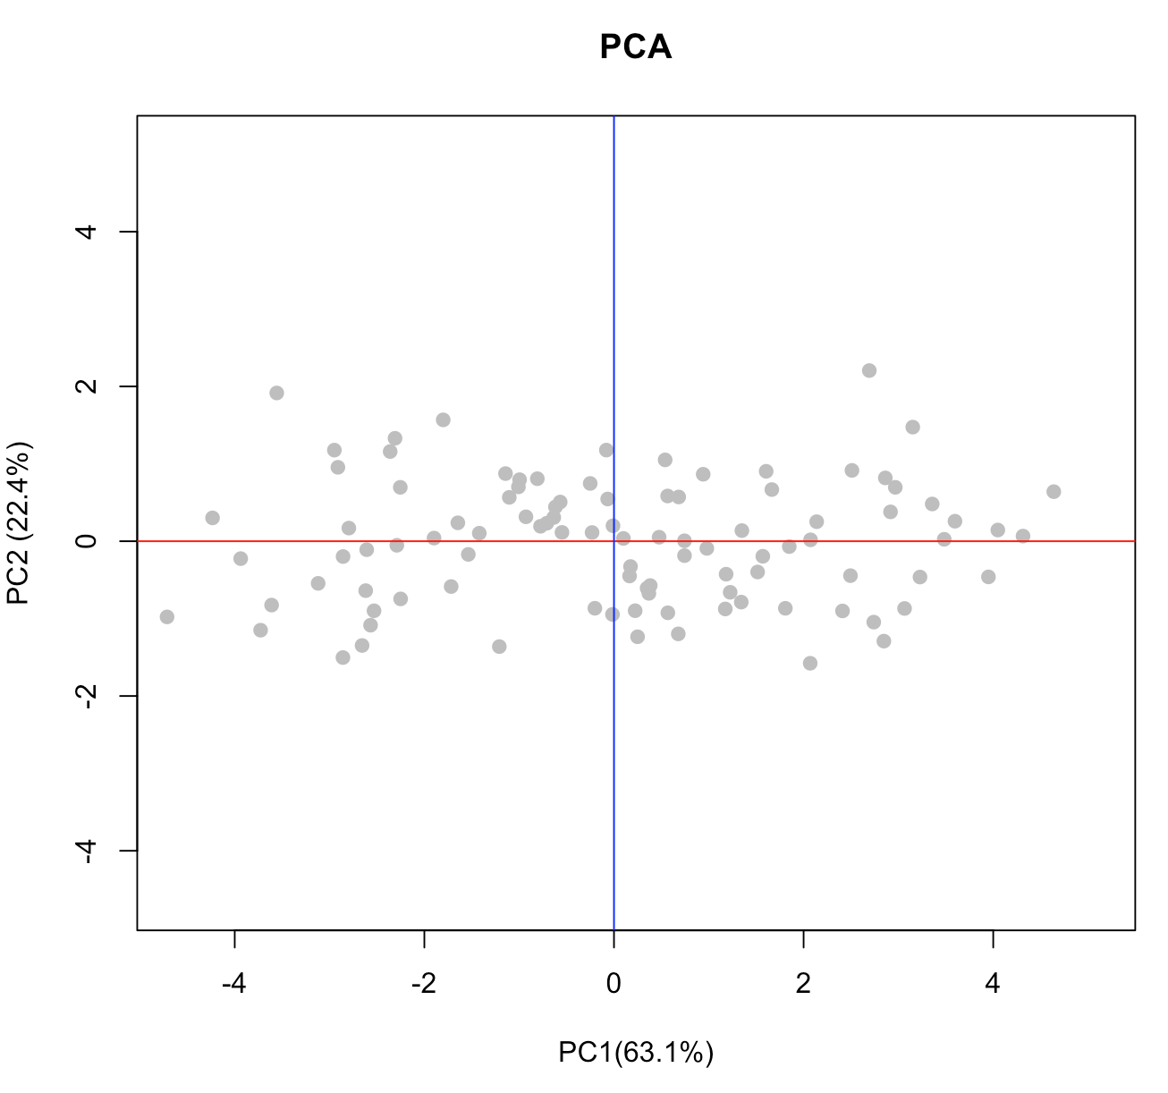
PCA. Prcomp from base()
x = rnorm(100) y = rnorm(100,x)
pca=prcomp(cbind(x,y)) names(pca) [1] "sdev" "rotation" "center" "scale" "x"
sdev- sd of Principal Components
rotation - the matrix of variable loadings (i.e., a matrix whose columns contain the eigenvectors).
The function princomp returns this in the element loadings.
center T or F, whether variables should be shifted to be zero centered;
scale T or F, scaling of the variables. By default is F, but advisable since will help to treat outliers;
x - the matrix of every point with location on PC.
plot(x,y,pch=19,col='gray',xlim=range(x,y),ylim=range(x,y),main='Original coordinates')
points(pca$center[1],pca$center[2],cex=2)
b1 = pca$rotation[2,1]/pca$rotation[1,1]
abline(a=pca$center[2]-b1*pca$center[1],b=b1,col='red')
b2 = pca$rotation[2,2]/pca$rotation[1,2]
abline(a=pca$center[2]-b2*pca$center[1],b=b2,col='blue')
dev = round(pca$sdev/sum(pca$sdev)*100,1)
plot(-pca$x[,1],-pca$x[,2],pch=19,col='gray',main='PCA',xlab=
paste('PC1(',dev[1],'%)',sep=''),ylab=paste('PC2 (',dev[2],'%)',sep=''),
xlim=range(x,pca$x,y),ylim=range(x,y,pca$x))
abline(a=0,b=0,col='red')
abline(v=0,col='blue’)
NB! If you have bad variance explanation by PCA, try scale and center data. If you have undetermined clouds of data, use PCA-> t-SNE. If your data is shrinked through one of components- it’s bad, because algorithm failed to find normal projection

Slide 5
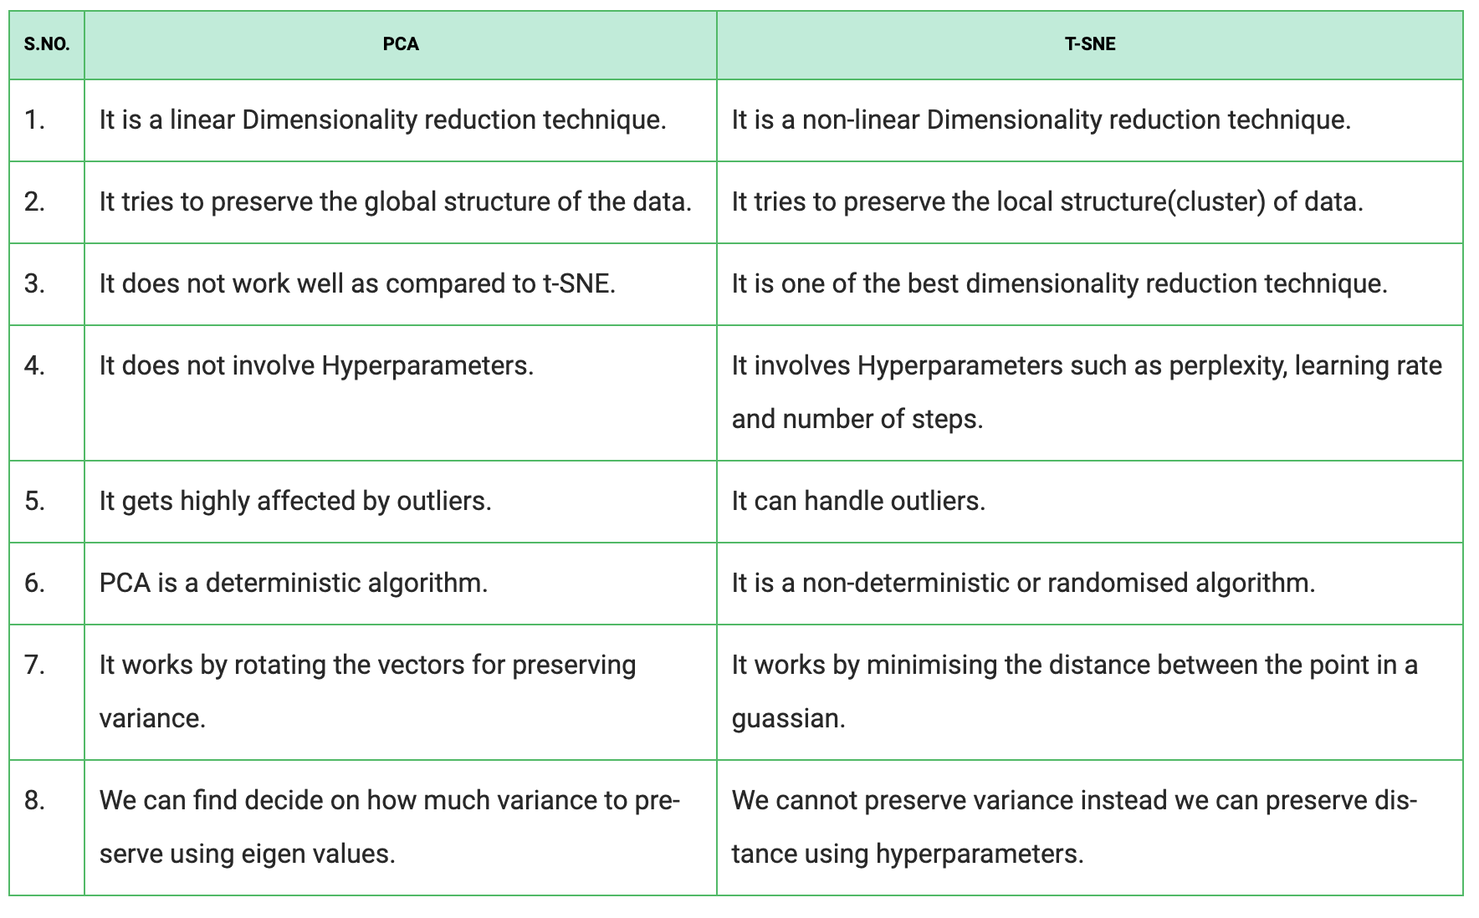

Slide 6
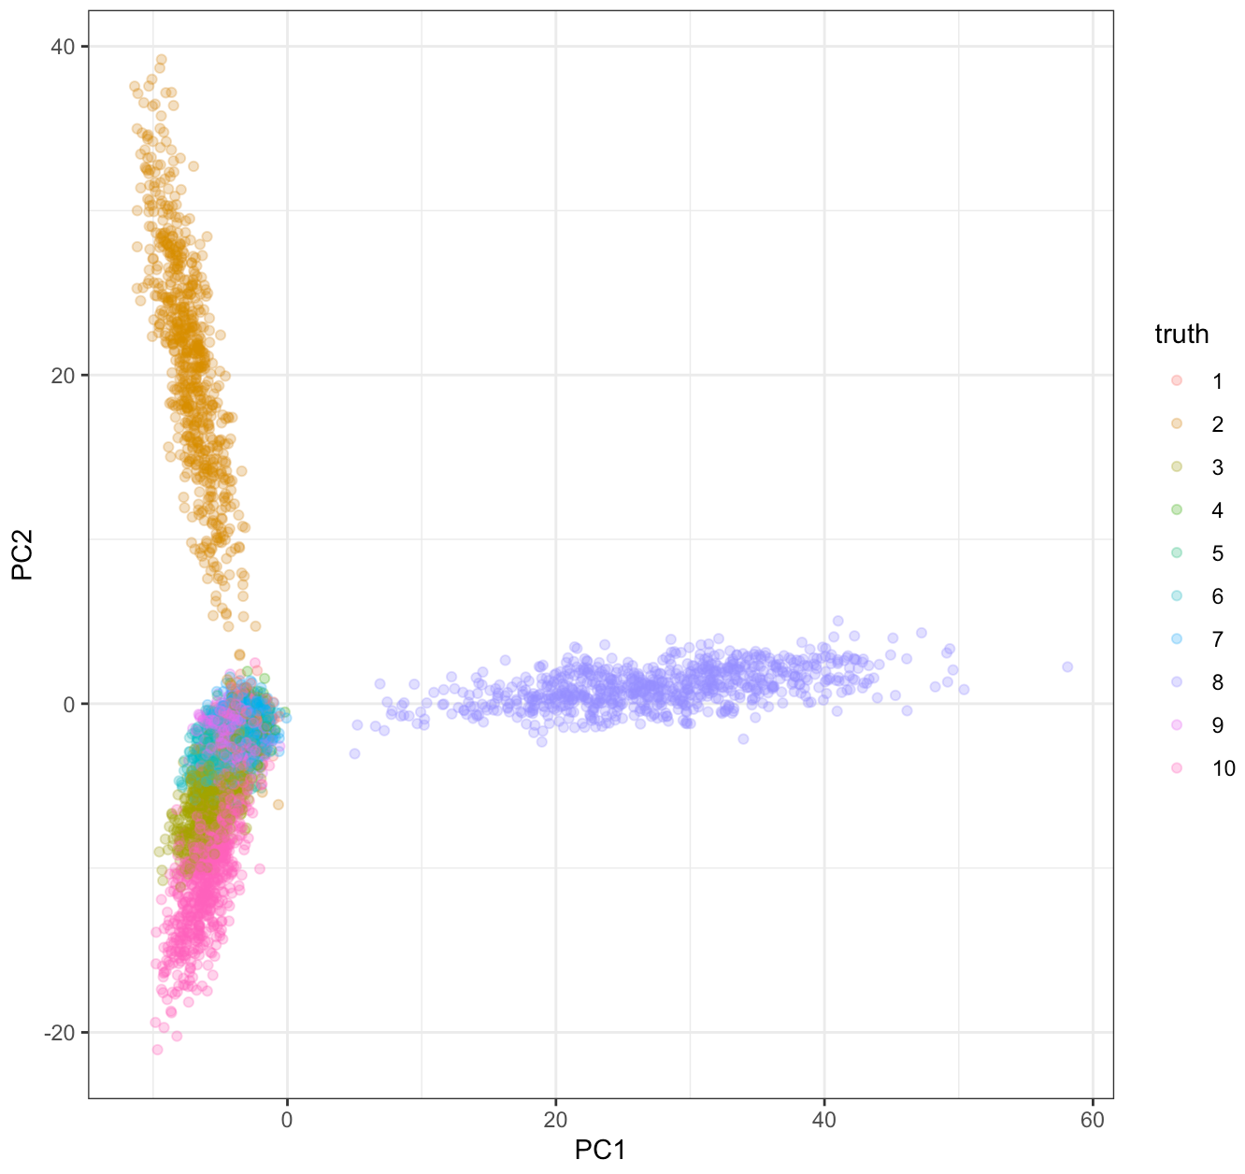
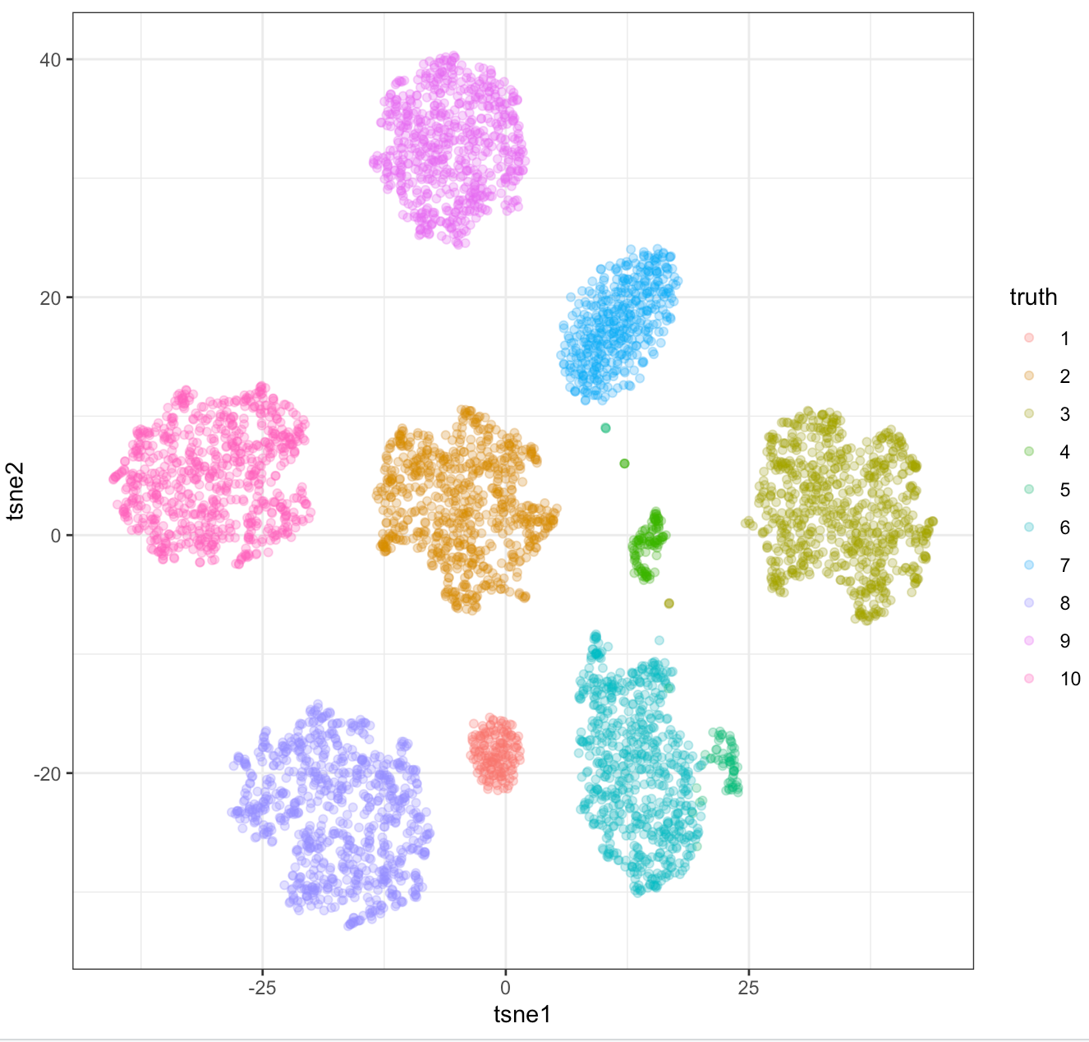
t-SNE. PCA upgrade
set.seed(1)
N = 5000; D = 100; data.norm = matrix(rnorm(N * D, 2), N); groups.probs = runif(10)
groups = sample(1:10, N, TRUE, groups.probs/sum(groups.probs))
for (gp in unique(groups)) {dev = rep(1, D); dev[sample.int(D, 3)] = runif(3, -10, 10)
data.norm[which(groups == gp), ] = data.norm[which(groups ==
gp), ] %*% diag(dev)
}
info.norm = tibble(truth = factor(groups))
#PCA
pca.norm = prcomp(data.norm)
info.norm %<>% cbind(pca.norm$x[, 1:4])
ggplot(info.norm, aes(x = PC1, y = PC2, colour = truth)) +
geom_point(alpha = 0.3) + theme_bw()
#TSNE
library(Rtsne)
tsne.norm = Rtsne(pca.norm$x, pca = FALSE)
info.norm %<>% mutate(tsne1 = tsne.norm$Y[, 1], tsne2 = tsne.norm$Y[,
2])
ggplot(info.norm, aes(x = tsne1, y = tsne2, colour = truth)) +
geom_point(alpha = 0.3) + theme_bw()

Slide 7
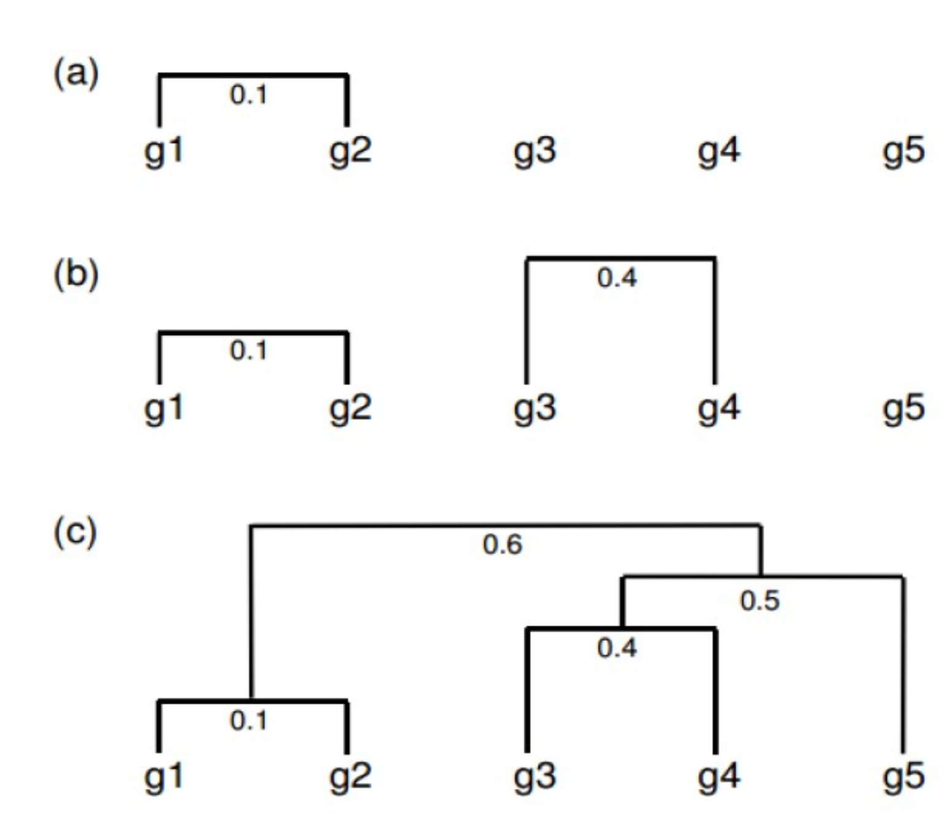
Clustering. How clustering work?
Place every i element into single cluster;
Find closest clusters;
Join them;
Calculate distance to neighbors;
Continue until there will be no unassigned elements left

Slide 8
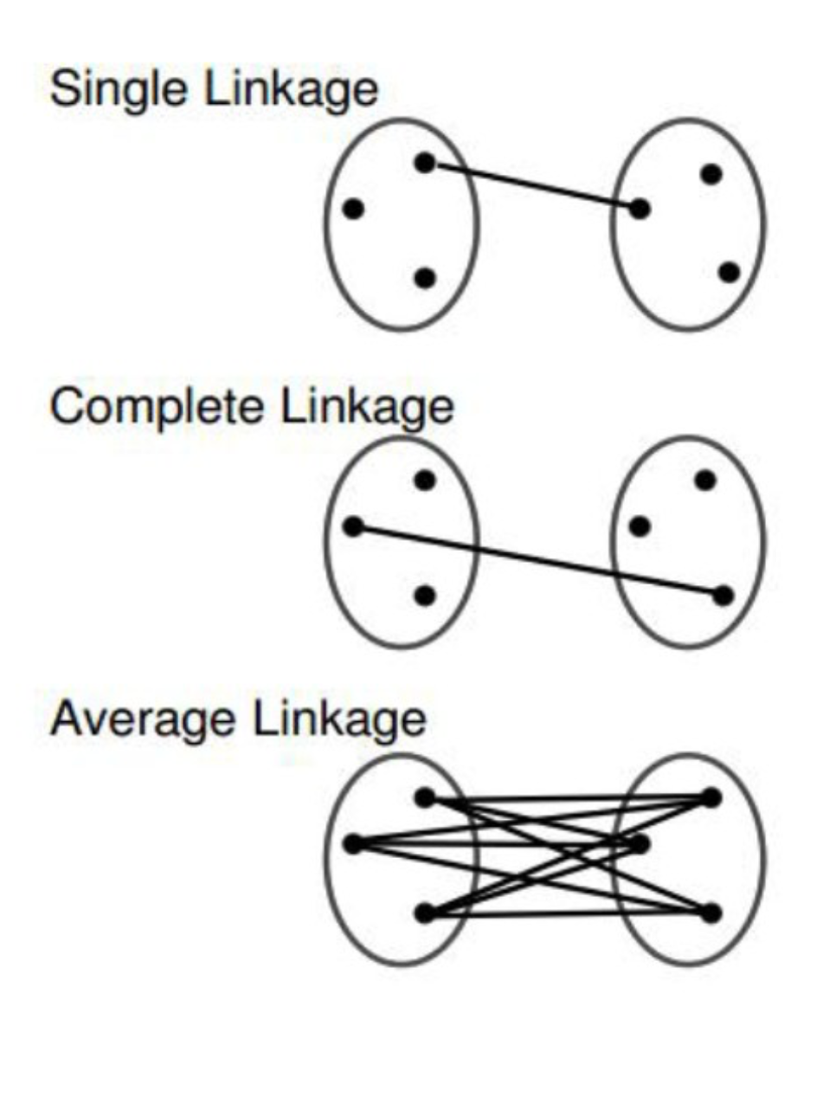
Clustering. Several ways to calculate distance
single (friend of friend) — distance to closest element;
complete — distance between farsher elements;
Average distance ☺

Slide 9
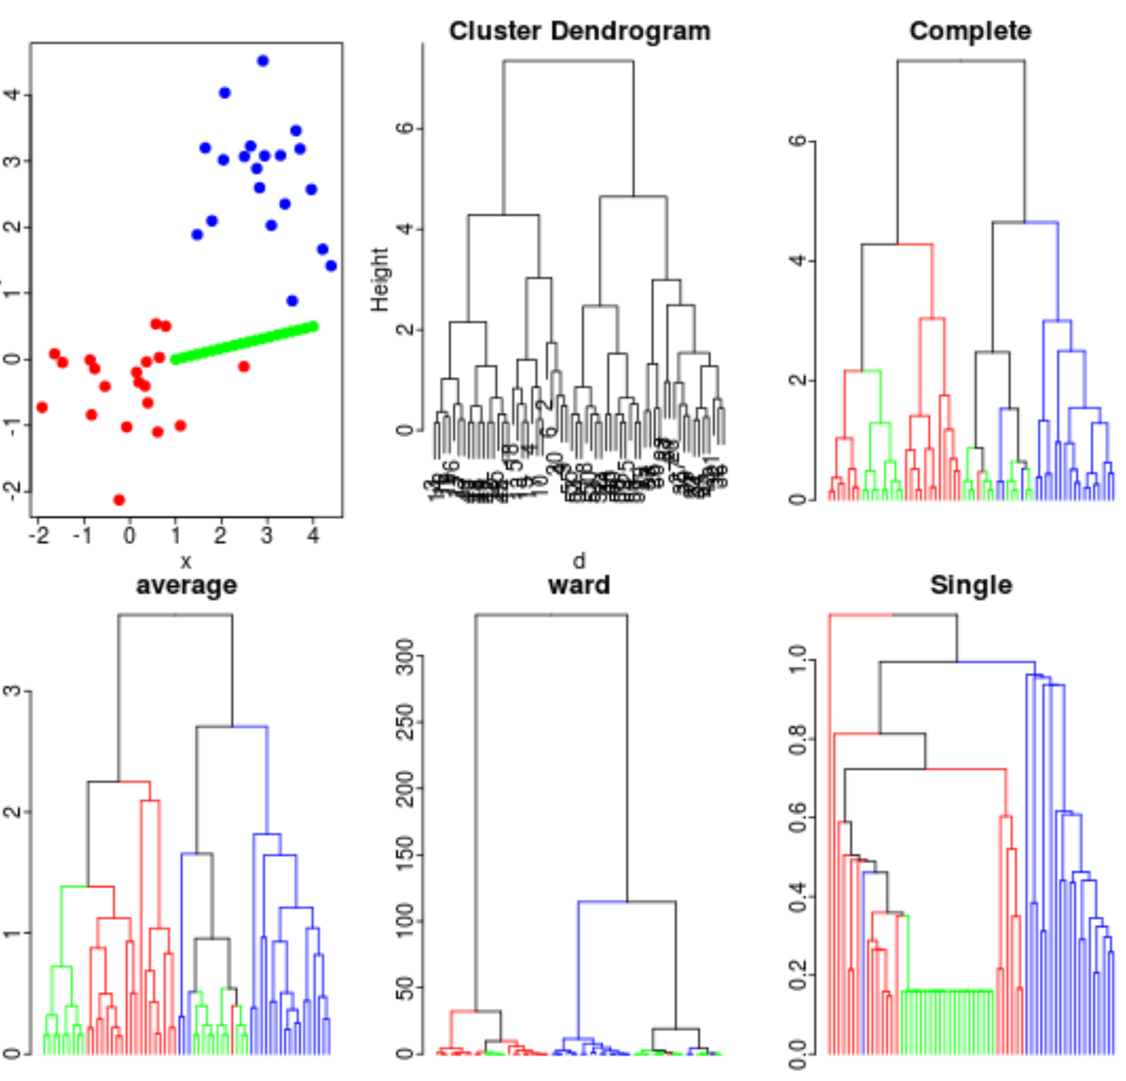
Clustering. Several ways to calculate distanse
d=dist(cbind(x,y),method='euclidean') h=hclust(d,method='complete') plot(h) dg = as.dendrogram(h)
colLab = function(n,cols) { leafs = order.dendrogram(n) leaf.col = unique(cols[leafs]) if(length(leaf.col)==1){
attr(n,'edgePar') = list(col=leaf.col) }
n }
dg = dendrapply(dg, colLab,col) plot(dg,leaflab='none',main='Complete')

Slide 10
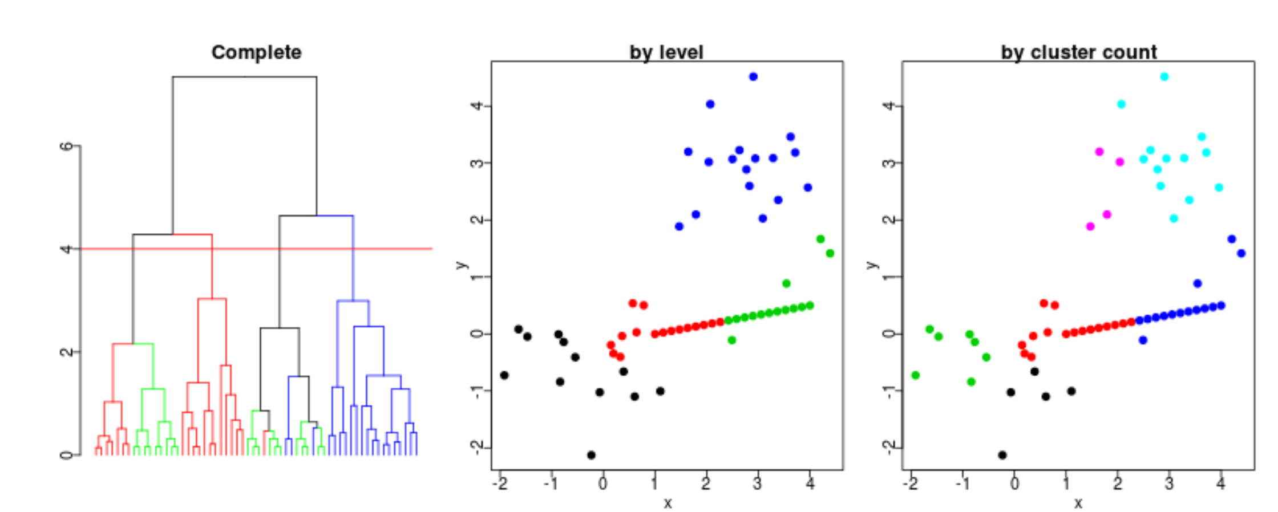
Clustering. Defining number of clusters
h=hclust(d) dg = dendrapply(as.dendrogram(h), colLab,col) plot(dg,leaflab='none',main='Complete') t=4 abline(h=t,col='red') cl = cutree(h,h=t) plot(x,y,col=cl,pch=19,main='by level') cl=cutree(h,k=6) plot(x,y,col=cl,pch=19,main='by cluster count')

Slide 11
Clustering. Summarize
NB!
There always will be clusters. Even on random data;
Clustering is, actually, an unsupervised ML. It means they are not validated as we treat this term;
This means bad hypothesis will lead to wrong results, and in biology we can interpret everything :)

Slide 12
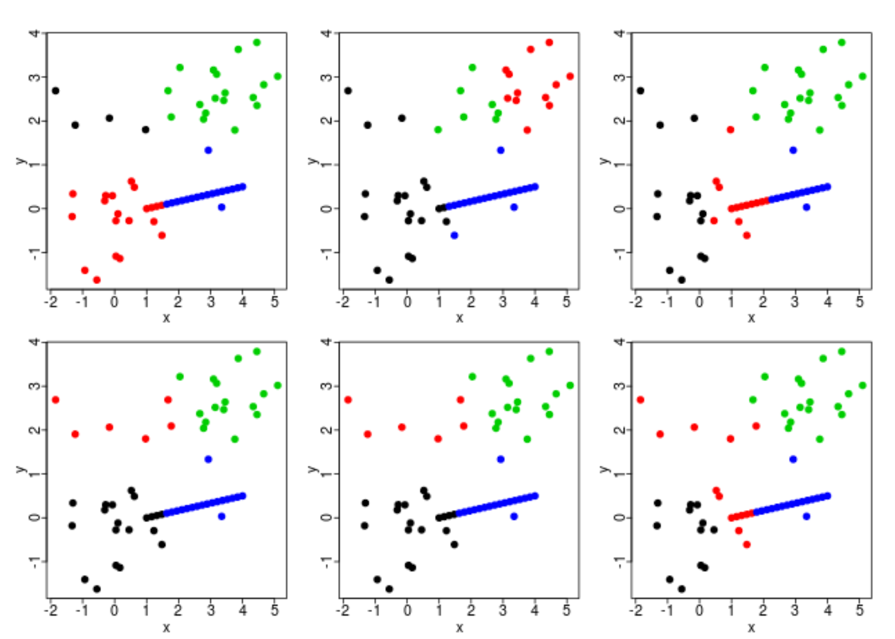
Clustering. K-means
Assign k clusters;
k initial "means" (in this case k=3) are randomly generated within the data domain;
k clusters are created by associating every observation with the nearest mean;
The centroid of each of the k clusters becomes the new mean;
Steps 3 and 4 are repeated until convergence has been reached;
NB! THE RESULTS ARE UNDETERMINED!
But how to define optimal number of clusters?

Slide 13
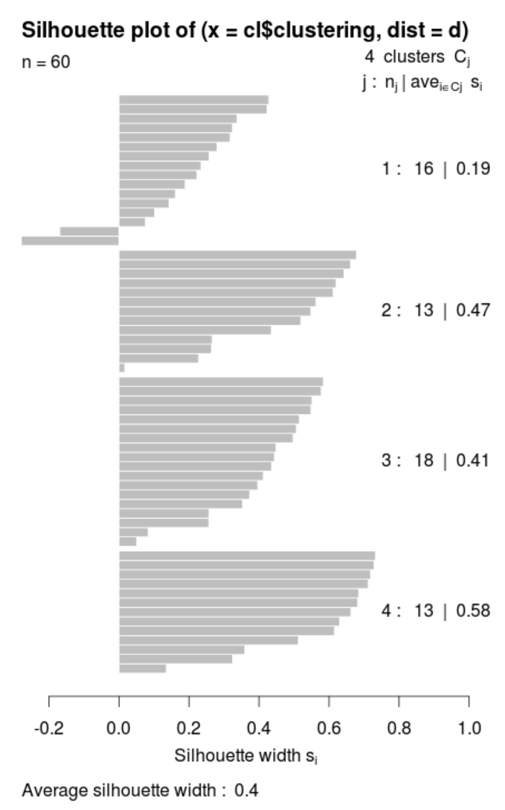
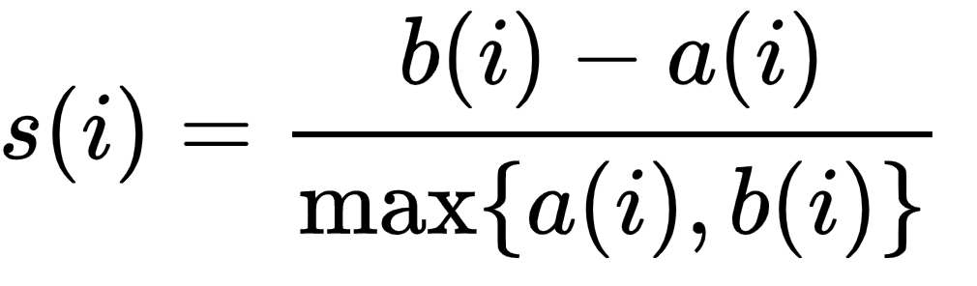
Clustering. Silhouette
a(i) is a measure how well I is assigned to its cluster
b(i) implies how I is badly matched to its neighboring cluster;
Ranges from [-1:1], the greater the better;

Slide 14
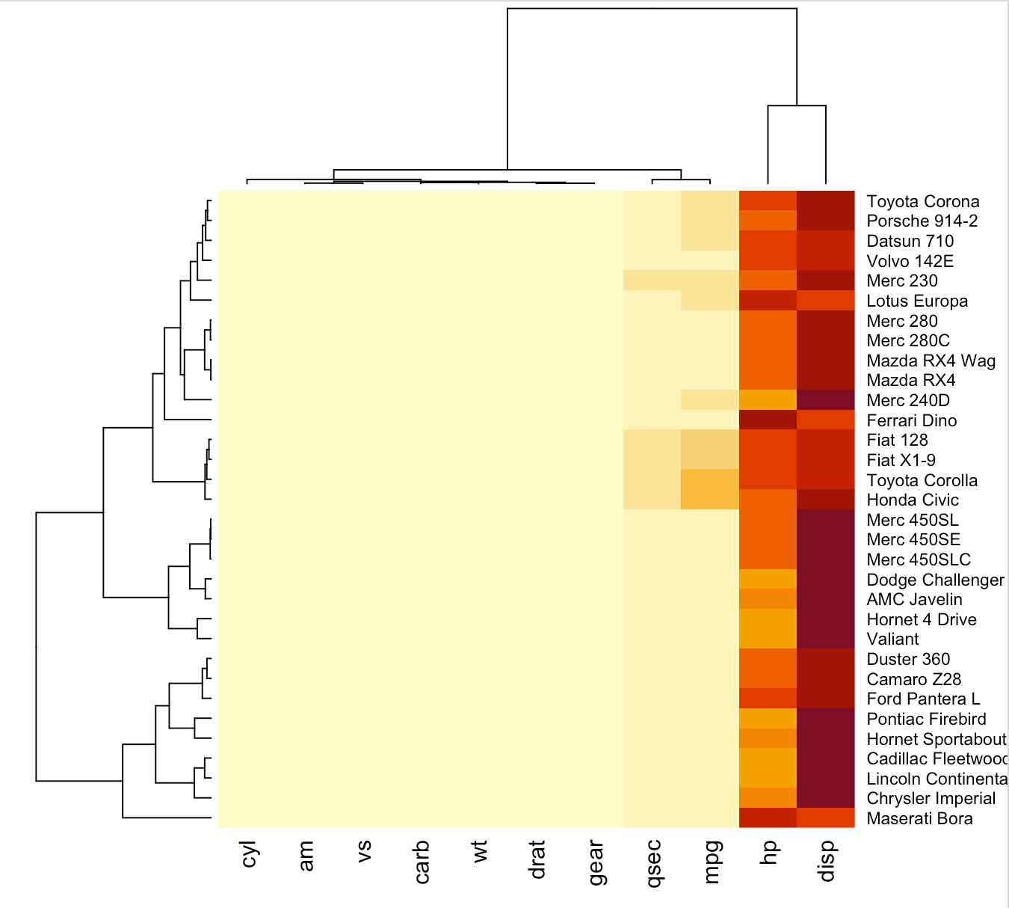
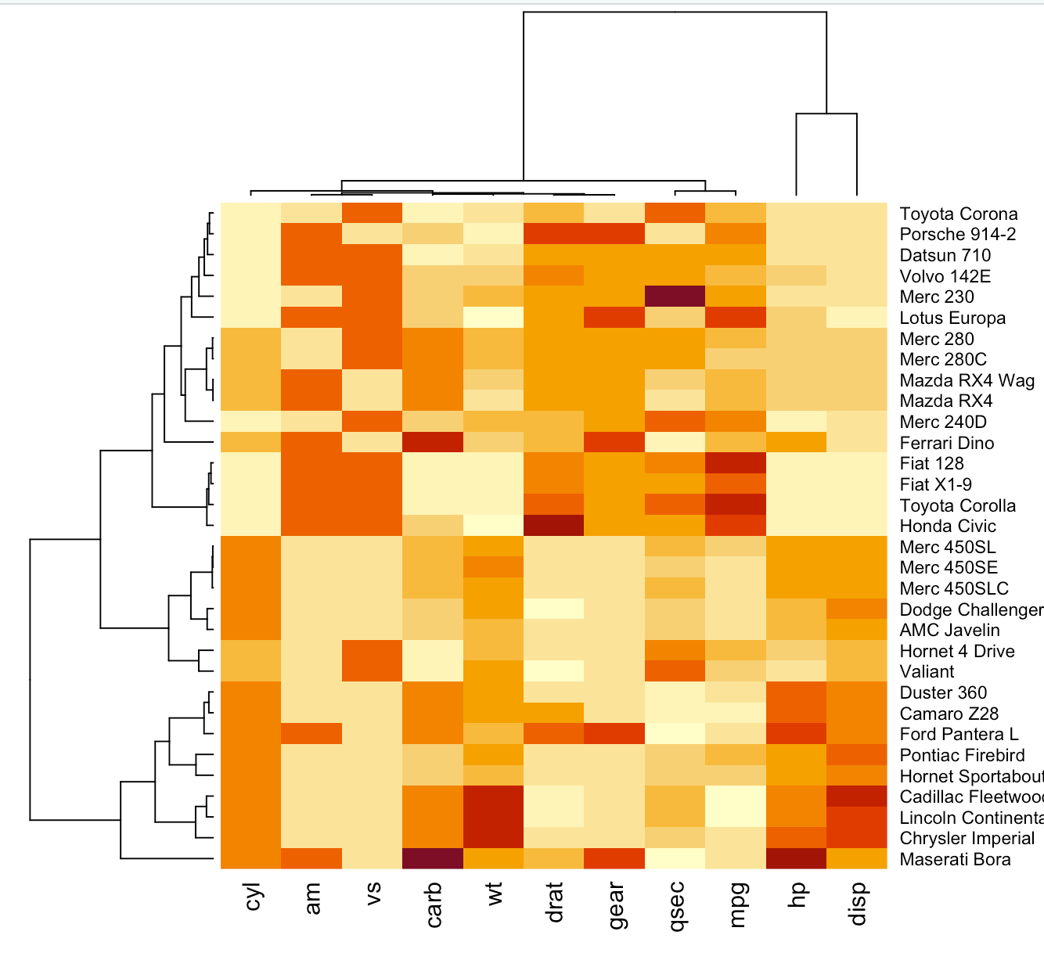
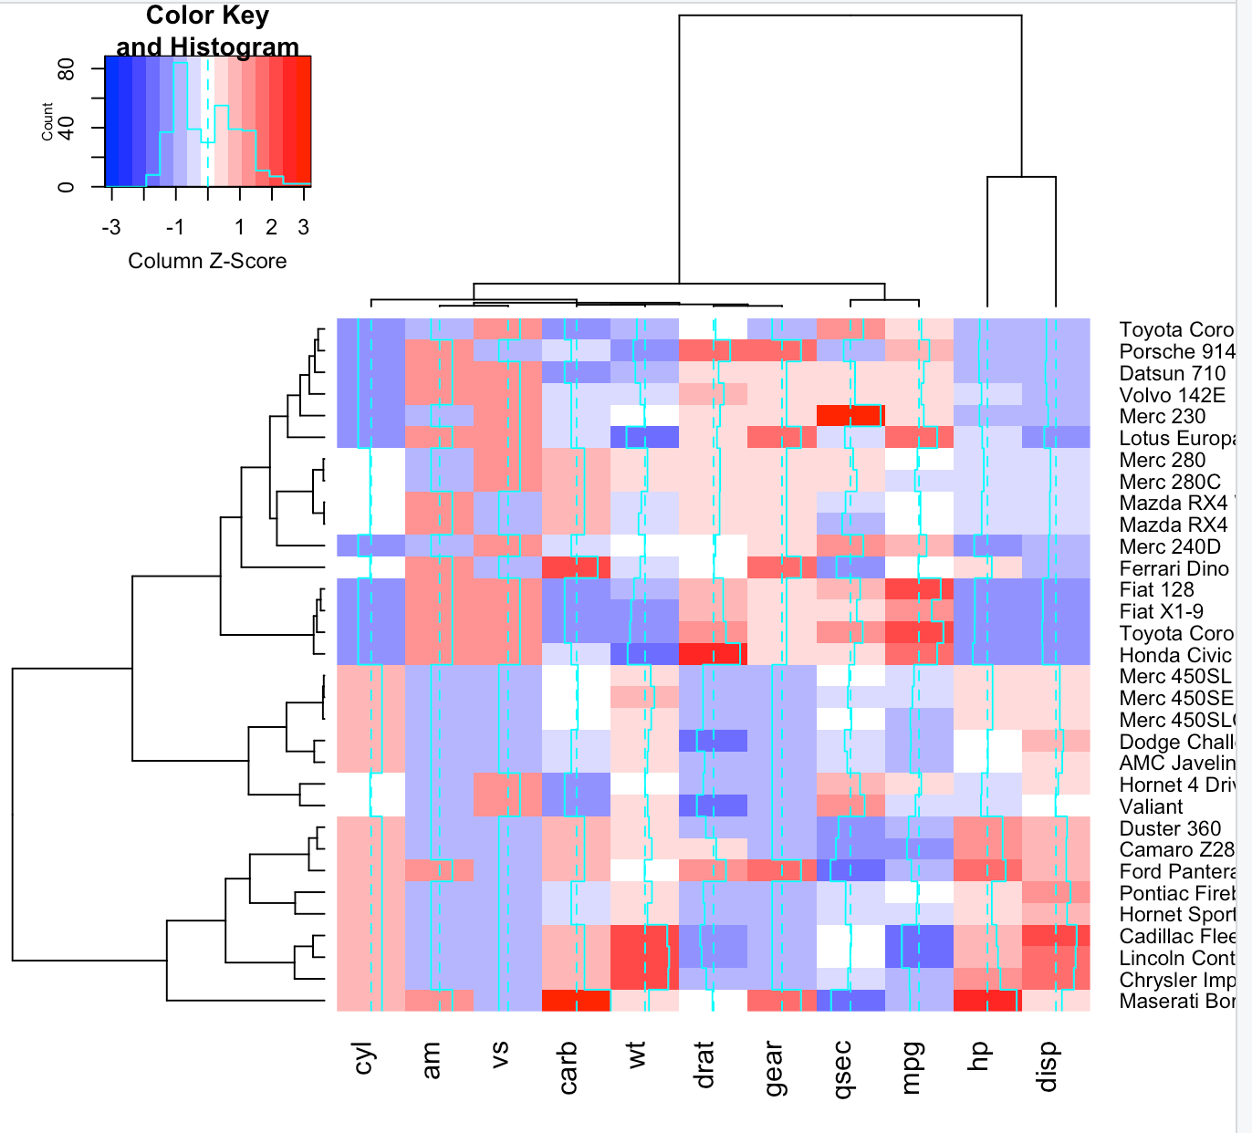
heatmap
Transfrom mtcars to matrix
data <- as.matrix(mtcars)
Default Heatmap
heatmap(data)
heatmap(data, scale="column")
Alternatively, you can use heatmap.2 function to adjust colors:
library(gplots)
heatmap.2(data,col='bluered',scale="column")

Slide 15
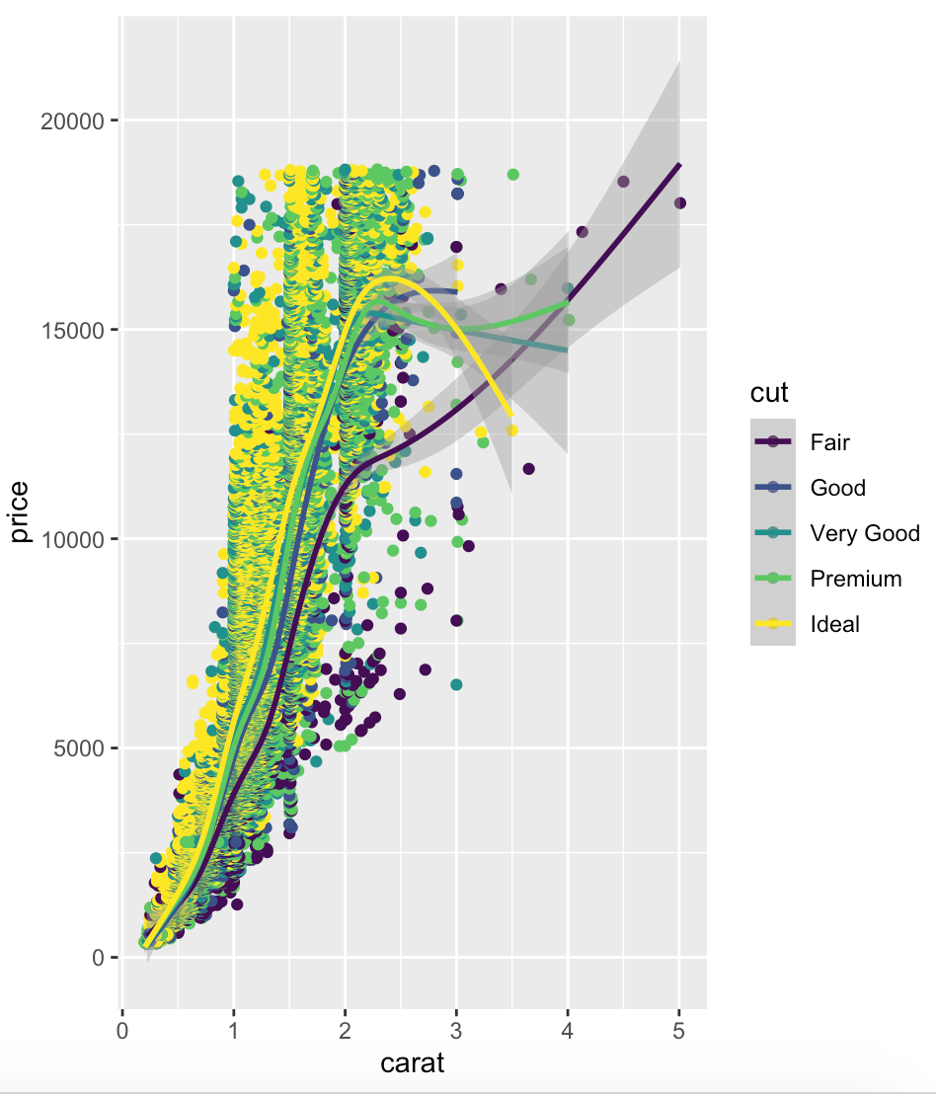
ggplot2
Relatively high level of entry in comparison with base.plot;
MASSIVE amount of options even without additional packages;
Large amount of additional libraries;
As a result we obtain ready-to-publish plots we don’t need to polish with photoshop ☺;
General usage:
ggplot() + “layers”. Layers- separate ggplot2-associated functions, imply the data you imputed with aes() in the ggplot header or can be modified with own aes() of the function.
library(ggplot2)
ggplot(diamonds) + geom_point(aes(x=carat, y=price, color=cut)) + geom_smooth(aes(x=carat, y=price, color=cut))
ggplot(diamonds, aes(x=carat,y=price,color=cut))+ geom_point()+geom_smooth()
will give the same result

Slide 16
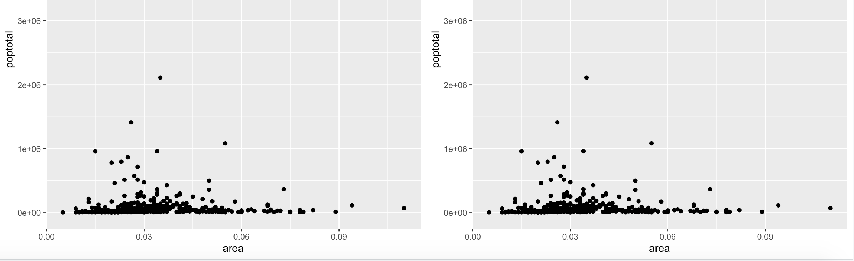
ggplot2. gridExtra
#No default way to locate several plots on screen. Use gridExtra instead
library(gridExtra)
plot1=ggplot(midwest, aes(x=area, y=poptotal)) + geom_point()
grid.arrange(plot1, plot1, ncol=2)

Slide 17
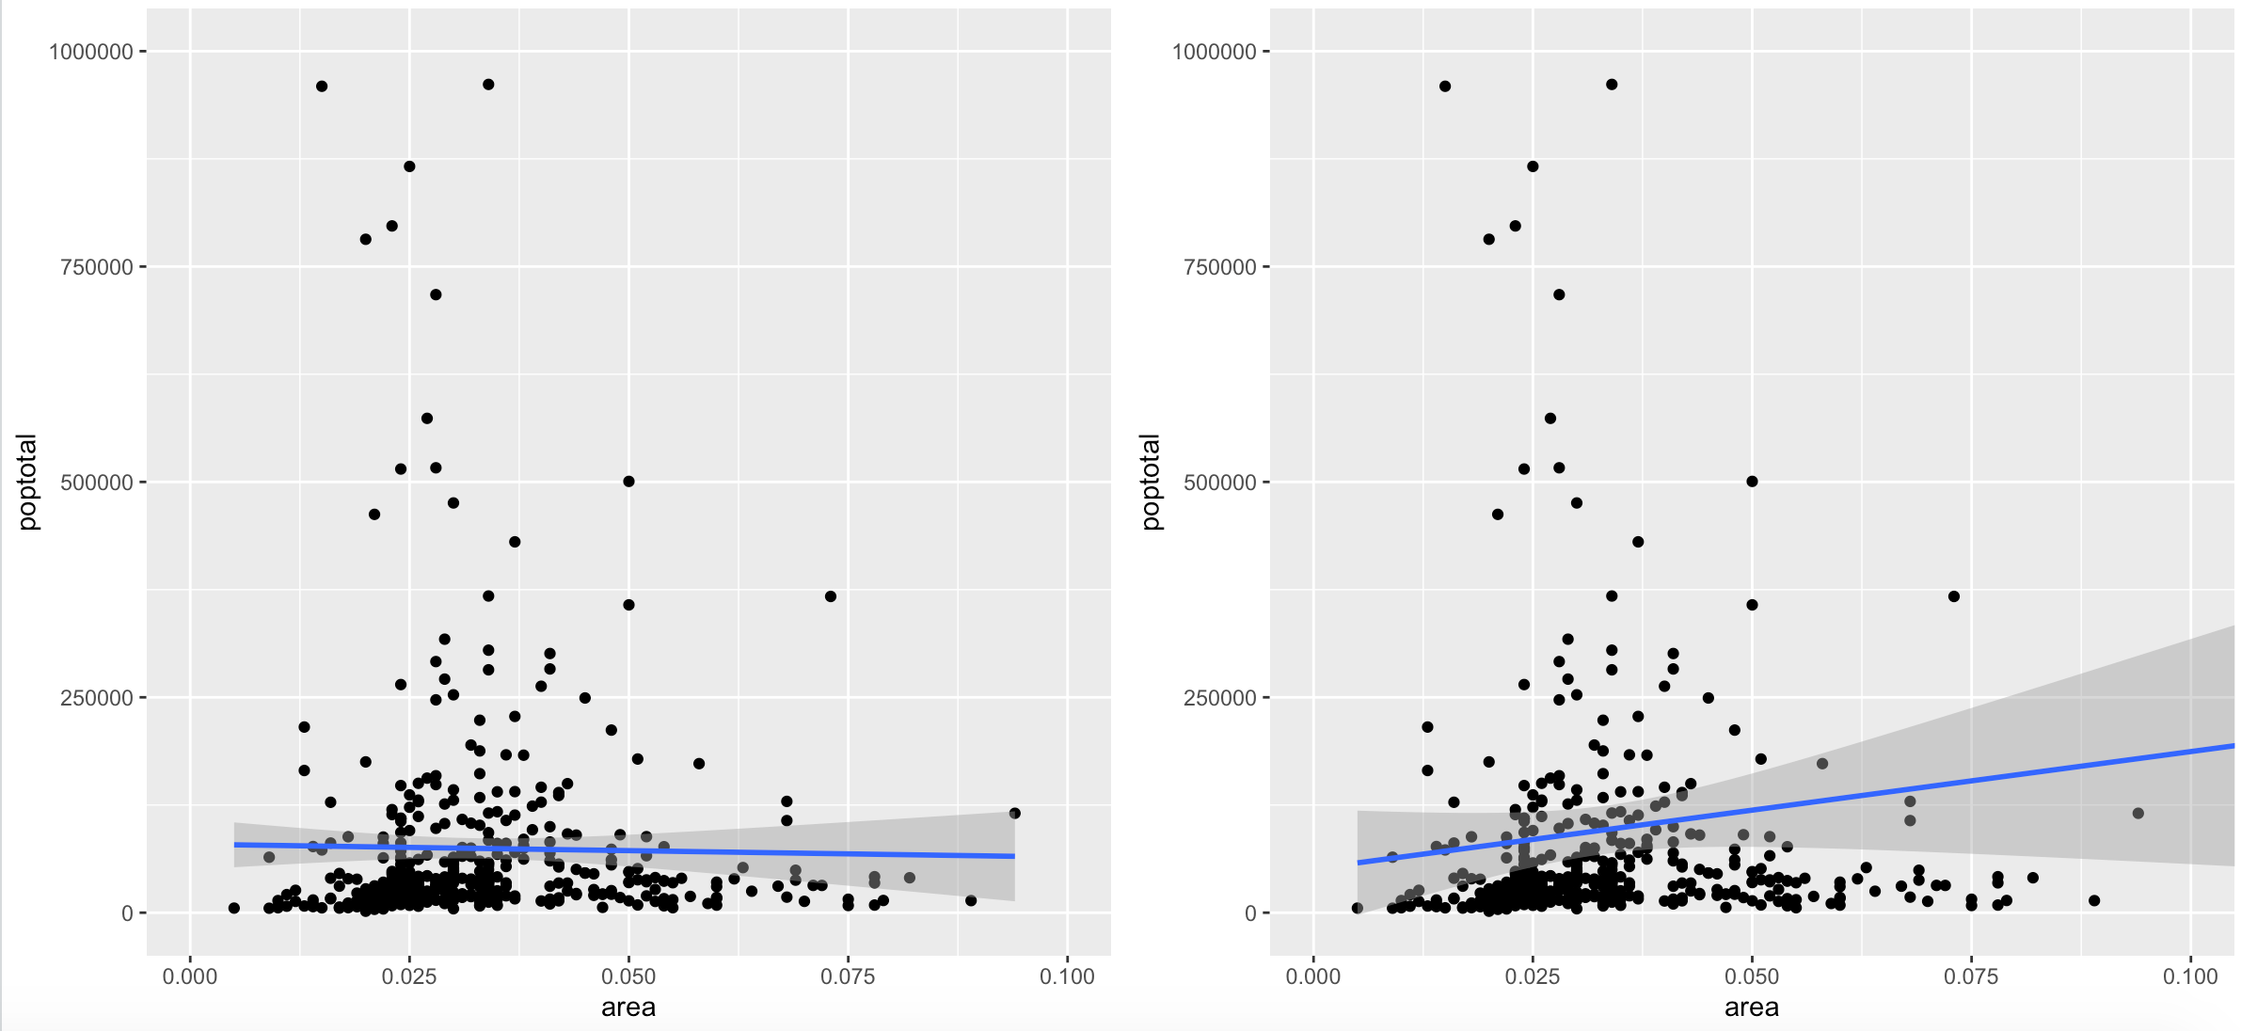
ggplot2. Limit the size of the plot
#Limit plot, remove pints outside of vector
g <- ggplot(midwest, aes(x=area, y=poptotal)) + geom_point() + geom_smooth(method="lm")
g1<-g + xlim(c(0, 0.1)) + ylim(c(0, 1000000))
#"Zoom" plot, keeping the data
g2 <- g + coord_cartesian(xlim=c(0,0.1), ylim=c(0, 1000000)) # zooms in
grid.arrange(g1,g2, ncol=2)
#NB! Line in 1 and 2 shape differs because in 1 the data being deleted. And you will get a warning:
Warning messages:
1: Removed 5 rows containing non-finite values (stat_smooth).
2: Removed 5 rows containing missing values (geom_point).

Slide 18
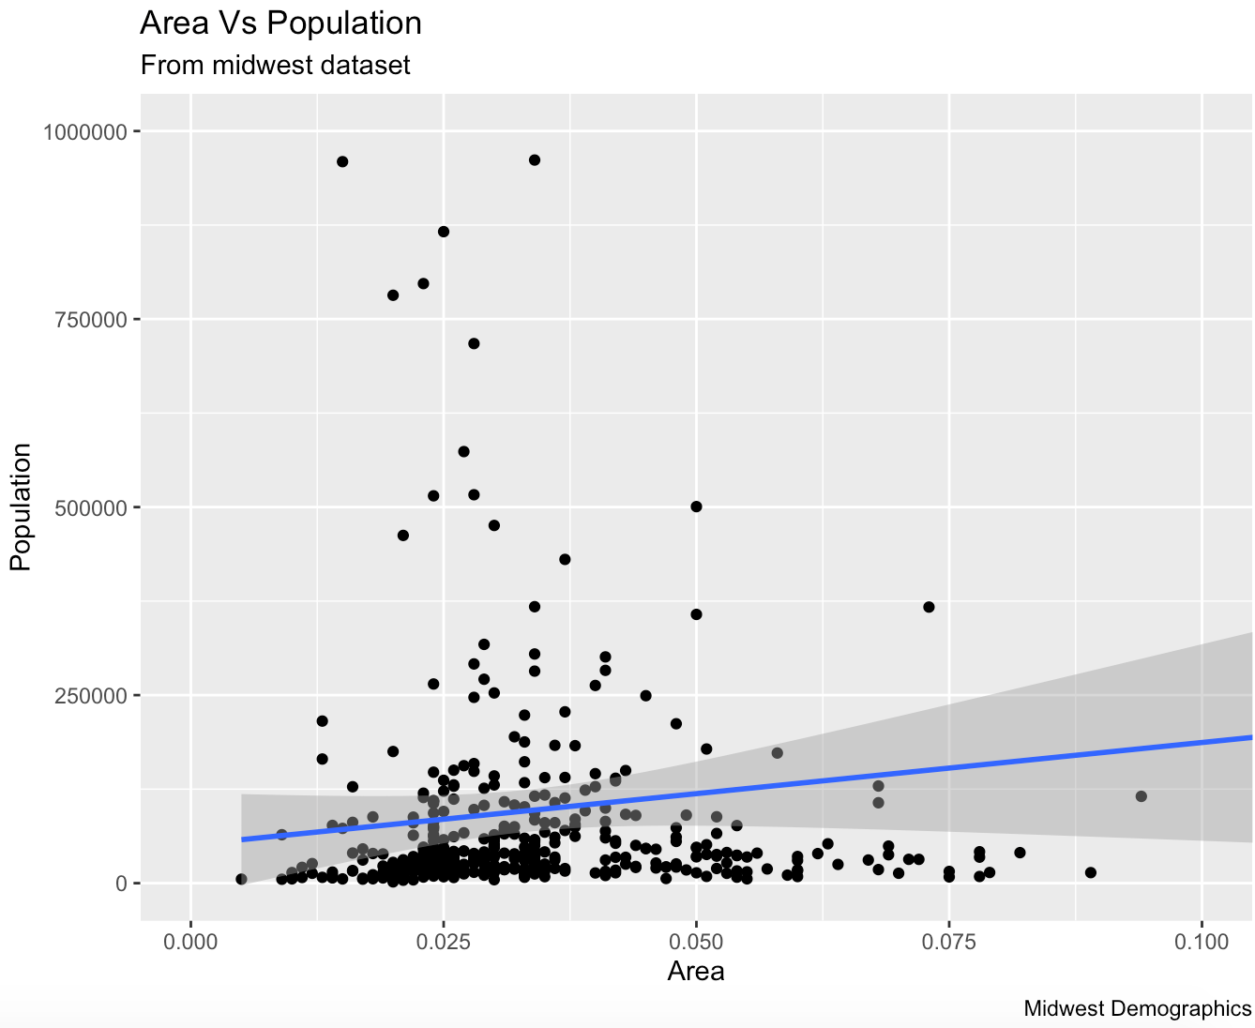
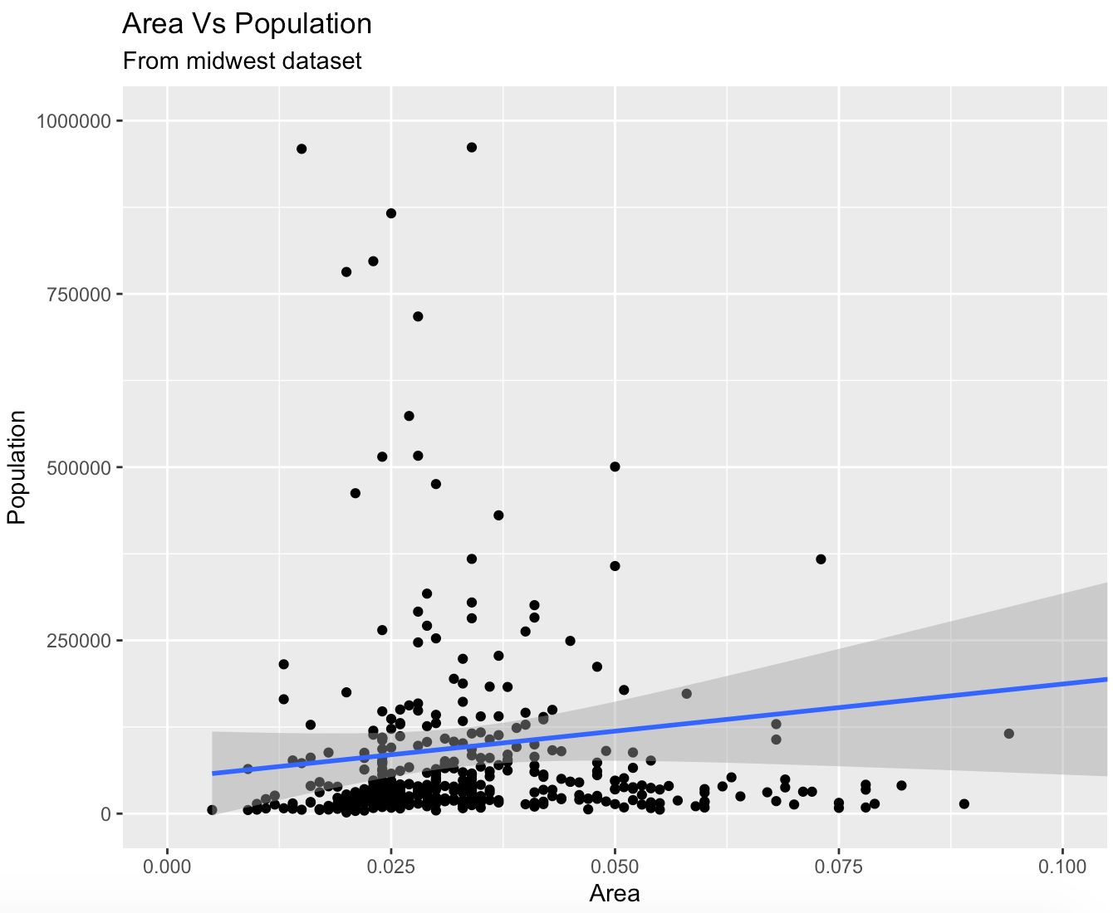
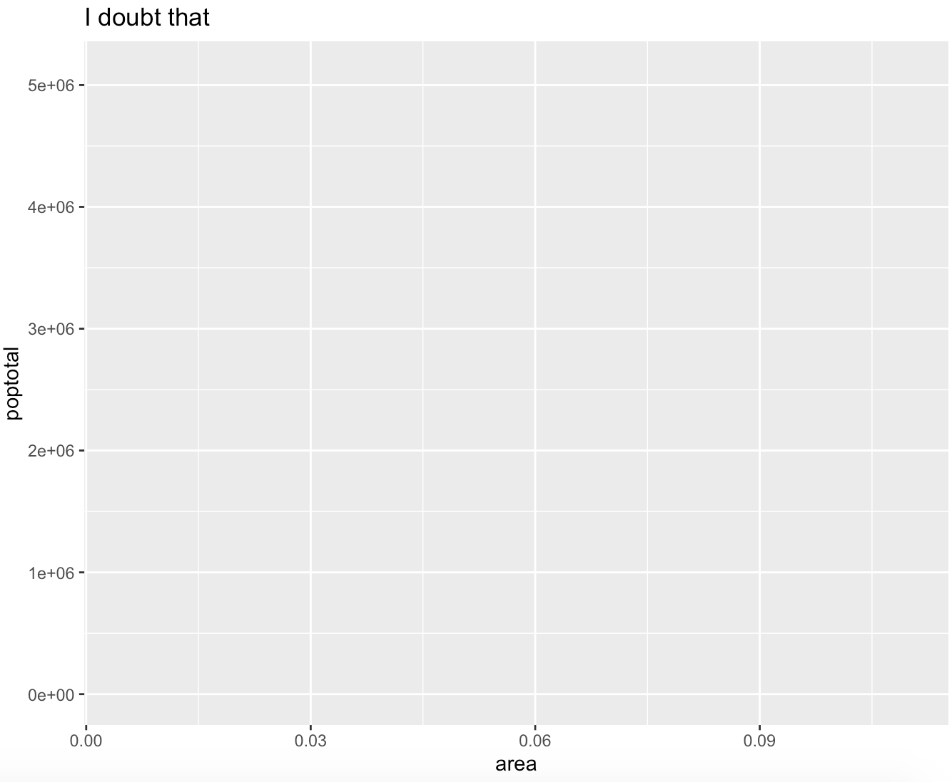
ggplot2. Two ways of adding text: labs() and ggtitle()
g <- ggplot(midwest, aes(x=area, y=poptotal)) + geom_point() + geom_smooth(method="lm") #
g1 <- g + coord_cartesian(xlim=c(0,0.1), ylim=c(0, 1000000))
g1 + labs(title="Area Vs Population", subtitle="From midwest dataset",
y="Population", x="Area", caption="Midwest Demographics")
g1 + ggtitle("Area Vs Population", subtitle="From midwest dataset")+ xlab("Area") + ylab("Population")
ggplot(midwest, aes(x=area, y=poptotal)) +
labs(title="Let's change this title!") +
labs(title='I doubt that’)
NB! you can modify the same layer as you want, but only the last function will be plotted

Slide 19
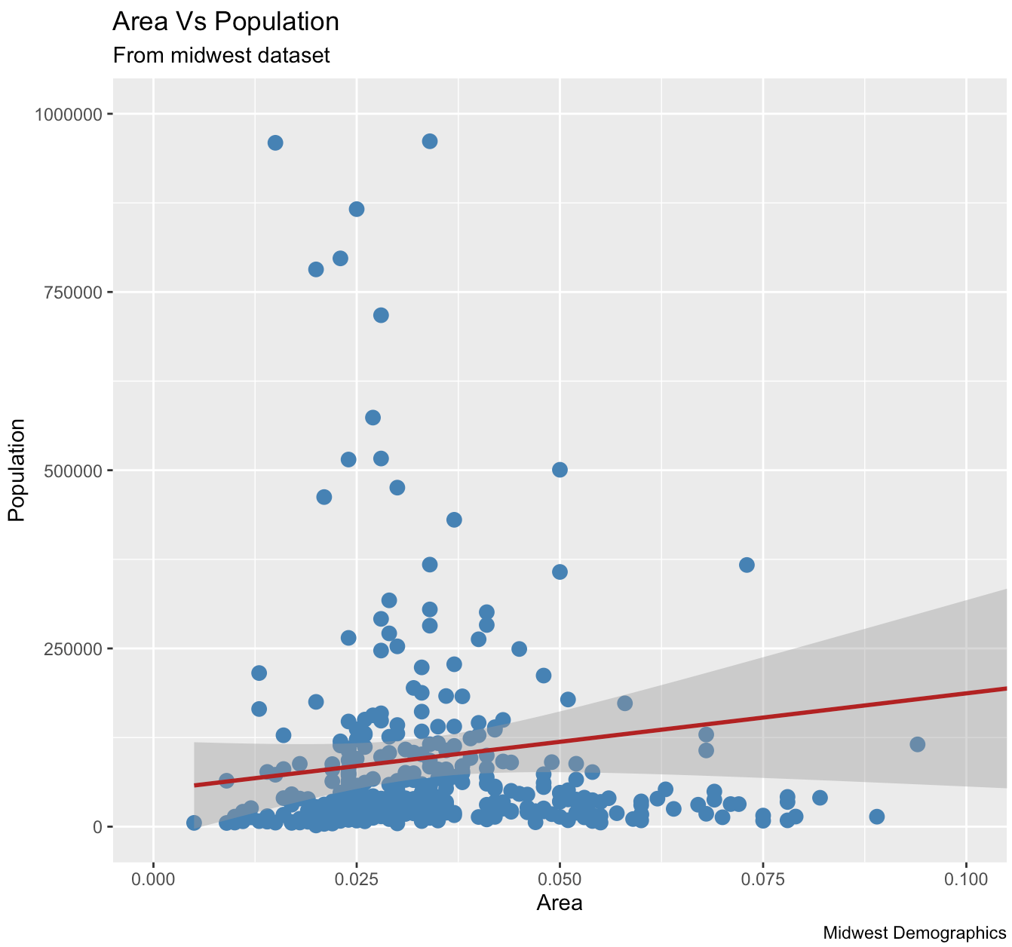
ggplot2. Change color and size.
Define aes, later will work only with additional parameters we want to modify
ggplot (midwest, aes (x = area, y = poptotal)) +
Adjust color of points and size
geom_point (col = "steelblue", size = 3) +
Custom formula, col and limits parameters
geom_smooth (method = "lm", col = "firebrick") + coord_cartesian (xlim = c (0, 0.1), ylim = c (0, 1000000)) +
Add custom labs
labs (title = "Area Vs Population", subtitle = "From midwest dataset", y = "Population", x = "Area", caption = "Midwest Demographics")

Slide 20
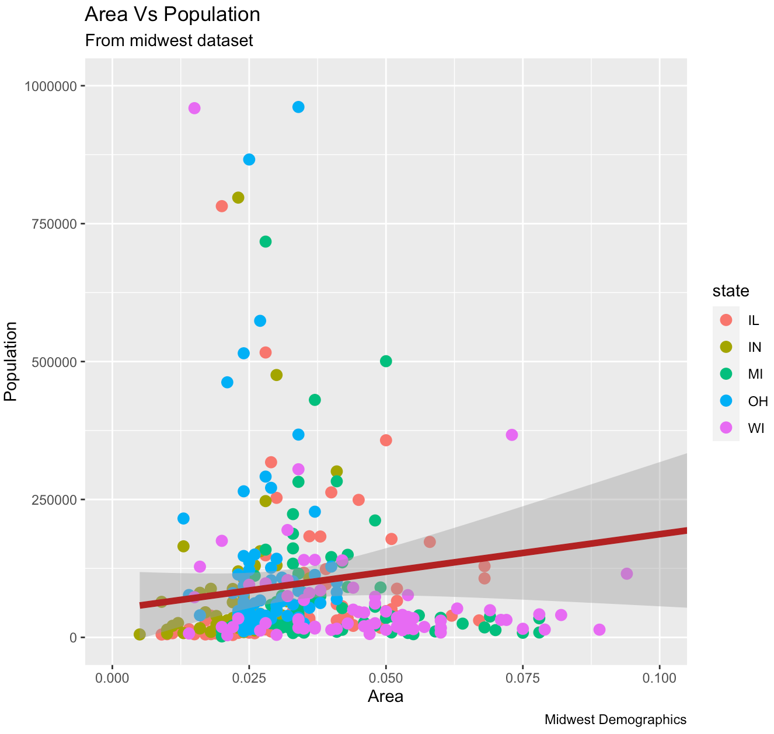
ggplot2. Change color and size.
You can make the data display "three-dimensional" and make the point color reflect the stategg = ggplot (midwest, aes (x = area, y = poptotal)) +
geom_point (aes (col = state), size = 3) + # Now the color of the picture will reflect the state.
geom_smooth (method = "lm", col = "firebrick", size = 2) +
coord_cartesian (xlim = c (0, 0.1), ylim = c (0, 1000000)) +
labs (title = "Area Vs Population", subtitle = "From midwest dataset", y = "Population", x = "Area", caption = "Midwest Demographics") # add custom axes
NB! but for this the dependency column must be a factor!

Slide 21
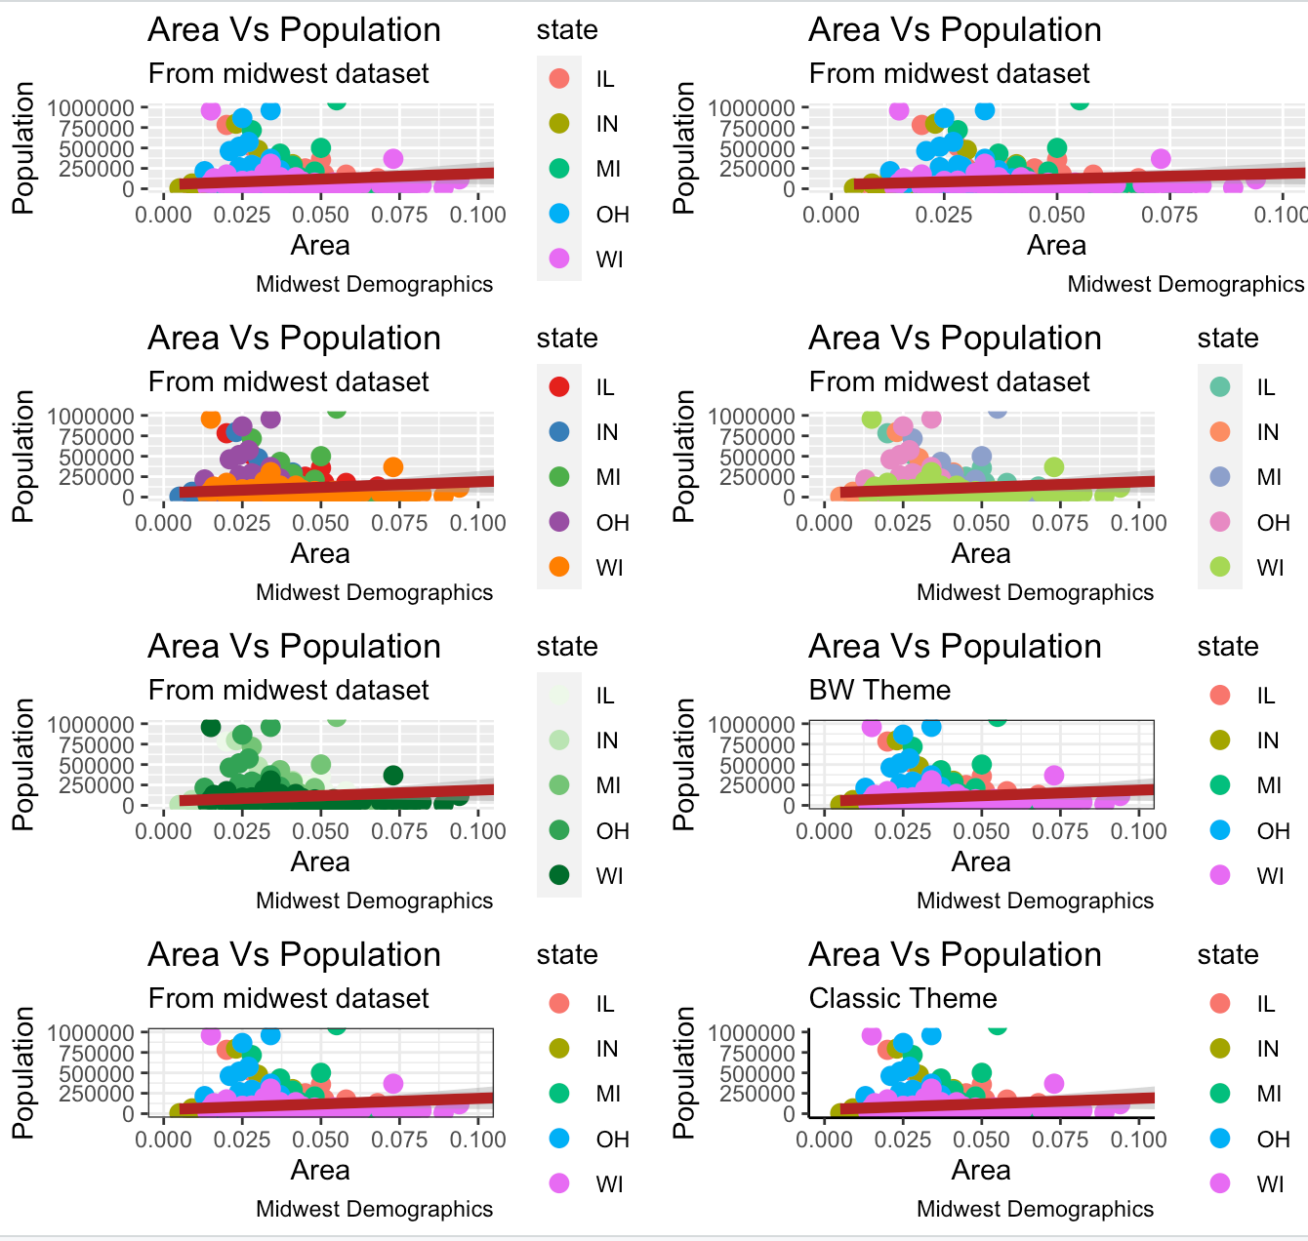
ggplot2. Themes
In addition to the banal col, you can use size, shape and fill.
A legend is created automatically, if we do not want a legend:
gg
gg + theme (legend.position = "None")
If you need to change the colors for the legend, you can do this with one of the sets:
gg + scale_colour_brewer (palette = "Set1")
gg + scale_colour_brewer (palette = "Set2")
gg + scale_colour_brewer (palette = "Greens")
Change the theme of the raft globally
gg + theme_bw () + labs (subtitle = "BW Theme")
gg + theme_bw ()
gg + theme_classic () + labs (subtitle = "Classic Theme")

Slide 22
ggplot2. To round up and useful functions
ggplot () + layers. Layered individual functions that accept either their date or, default, the date given in ggplot ().
The layer entered later determines the type of chart and cancels the “previous” assignment.
Pictures "overlap" each other in the order in which you registered them.
ggplot () creates an activity field
aes () assign a range of x and y values. In addition, you can add additional parameters. Such as color and size
geom_point () adds points to the chart
geom_smooth () adds curves to the graph
geom_hist () add histograms to the chart
geom_line () add lines to the chart
geom_boxplot () add boxplot
geom_bar () add barplot
geom_density () add a graph of the probability density distribution of the sample
xlim () ylim () coord_cartesian () limit the axis.
NB! xlim () ylim () removes data from the drawing, which often entails undesirable things, while coord_cartesian () honestly limits the area of ​​construction.
scale_x_continuous () scale_y_continuous () axis labels manipulation
labs () ggtitle () xlab () ylab () text on axes. labs () duplicates ggtitle () xlab () ylab () functions
theme_bw () theme_classic () - change plot themes
scale_colour_brewer () change, for example, the color of the legend
scale_color_manual () change the color of the legend
theme () allows you to control most of the variables. A kind of analog par
geom_text () add custom text to the raft.
USEFUL LIBRARIES
grid.arrange () multiple plots on single canvas
grid () similarly, allows you to place multiple plots on single canvas
ggrepel () an optional package for signatures on the plot

